Slide 1
Ames, Iowa in Focus: Using Pertinent Economic Data to Predict Housing Sales Prices
Sonny Desai, Northwestern University
Contact: sjdesai87@gmail.com

Slide 2
Research question & modeling problems
Research Question(s): Using the vast Ames, Iowa dataset, can we create models that will help predict sales price for Homeowners based upon the homes’ measurable data and qualities. Can we also provide an accurate prediction for those who are looking to purchase homes in the area.
Homeowners and potential homeowners face large amounts of uncertainty with an accurate valuation of the homes they would like to sell or purchase. By using historical data, we can try to minimize this uncertainty and bring clarity to these buyers/sellers by correctly predicting what a home would be valued at in the Ames, Iowa market based upon historical data.
We will create multiple models to test which one has the best accuracy, using the categorical data provided in the dataset to predict sales price.
The models to be created are: PCA, KNN (K-means clustering), & Hierarchical clustering
We will test these various models, provide results and analysis, and make further recommendations on the research question

Slide 3
About the data…
This dataset covers housing and location information concerning homes in the Ames, Iowa area. The data has both categorical and non-categorical variables and has missing or null values.
This project will be focusing on the response variable of Sales price, and the variables that have a large correlation to the response variable.
The data set covers 1,500 residential homes in Ames, Iowa consisting of data from taken from the years 2006 to 2012.
It consists of a total of 82 variables around this housing and location data.

Slide 4
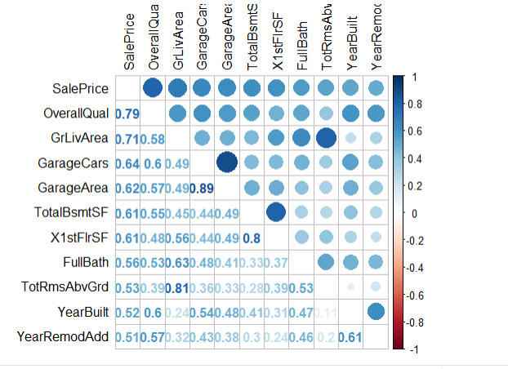
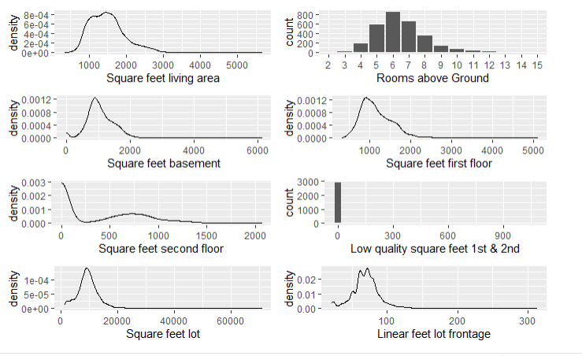
Exploratory data analysis (EDA)
The models we have chosen all require numeric, continuous variables, thus we will first eliminate all the variables that are not continuous.
This leaves about 34 variables to choose from, and we will include all of them in our model testing. Although some variables might be very similar to one another, we include all for this first round.

Slide 5
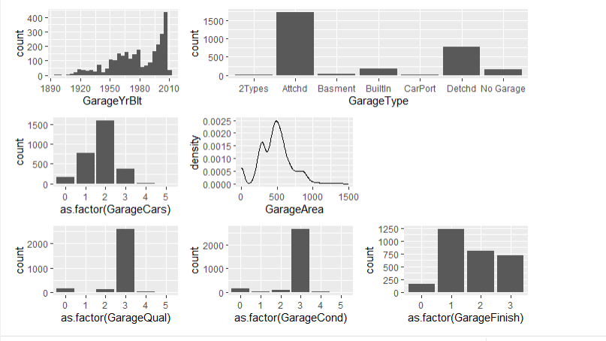
Exploratory data analysis (EDA)
Of the remaining variables, there are still quite a few variables which have null values. This provides a unique challenge as they can either be dropped or replaced with other values. Here, we have chosen to use the mean values for each variable to replace the null values with.
The models we selected also perform best on scaled data, so we will scale all the variables

Slide 6
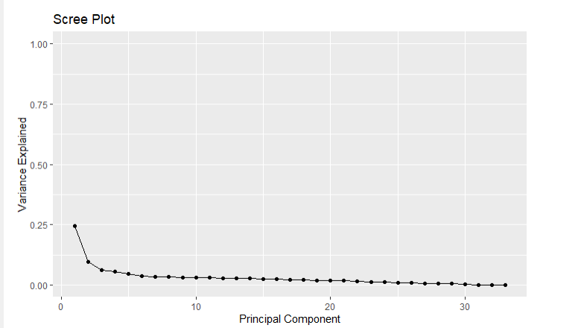
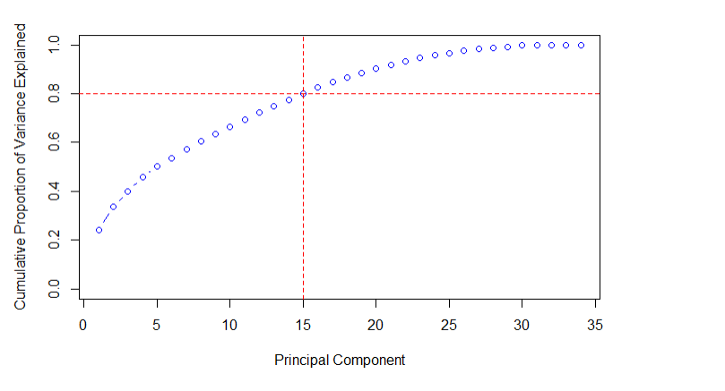
Principal component analysis (PCA)
Our Scree plot shows the PCA was successful but only a small percentage of variance was explained – 25%.
Total variance explained plot shows that 15 components are the optimal amount of clusters to keep about 80% of the variation of the data accounted for.

Slide 7
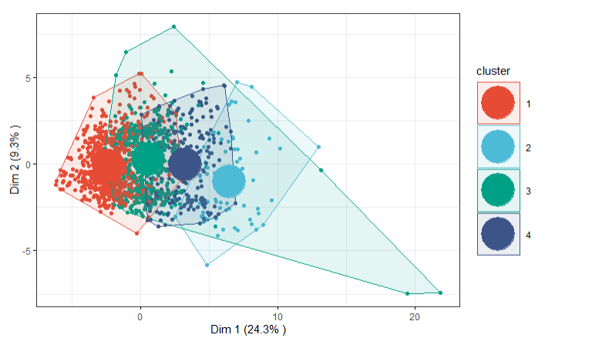
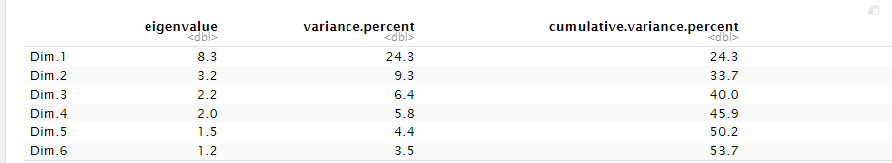
PCA with k-means clustering
PCA with K means showed that 53.7% of variance could be reported over 6 dimensions which was an increase on just the PCA model of 25%
This model scored low in accuracy percentage with only 48.7% accuracy leaving large room for improvement.

Slide 8
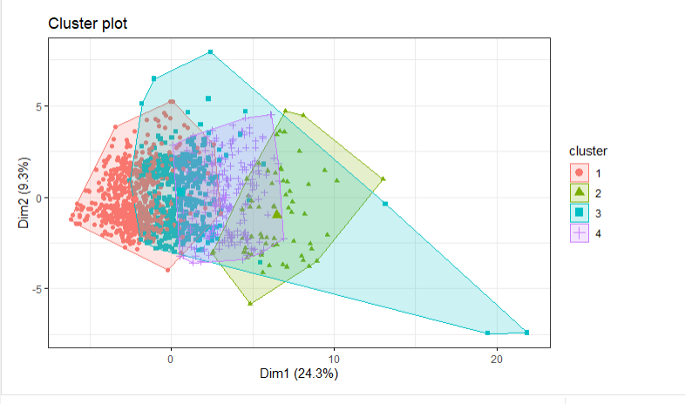
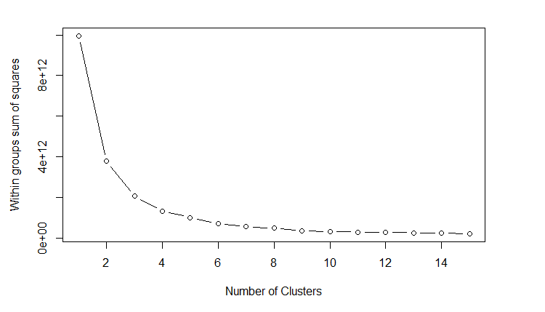
K means clustering on original data
The elbow chart for ideal clusters is difficult to read – it initially begins to curve at 2 but does not fully curve until 4, so we decided on 4 clusters.
This model proved very successful with a 86.7% accuracy rate.

Slide 9
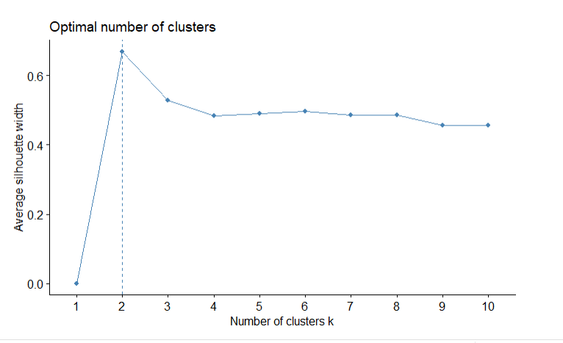
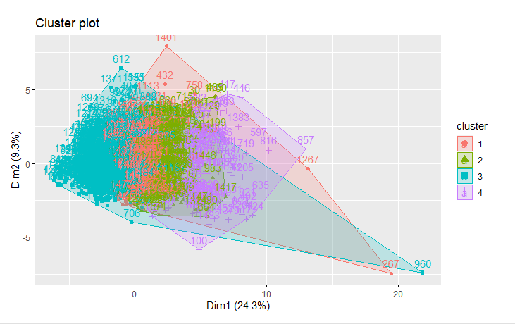
Hierarchical clustering
The optimal numbers of clusters for hierarchical was very interesting as it only listed two clusters as the optimal amount. However, the clustering model eventually put things into four different clusters.
It was difficult to gauge the percent accuracy with this model. But we compared the results of the clustering on sales price and they compared favorably to the original sales price. The K-means clustering was still more accurate though.

Slide 10
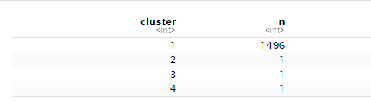
Comparison of models & Analysis
In sum, 3 models were tested: K-means on PCA data, K-means on original data, and Hierarchical clustering on PCA data.
The highest performing model was the K-means on original data , and although the Hierarchical was difficult to gauge for accuracy, it followed second, followed last by the K-means on PCA data. The k-means was a high performing model with nearly 86% accuracy suggesting it could be improved even further with some changes.
This model shows that homeowners and homebuyers can expect that they can get a better picture of valuation of homes in the Ames, Iowa market based upon specific data provided for the homes. Although not 100%, the high figure shows great potential in reducing uncertainty!
The Hierarchical clustering model showed interesting results, especially when I cut the tree. Most of the results for k=4 showed up in the first cluster. However, when I cut the tree with k=300, the clusters were more spread out evenly. Obviously there shouldn’t be 300 clusters but it was interesting to note.

Slide 11
Final thoughts & Future research
This was a very successful first attempt on using different models for the Ames, Iowa Dataset. One of the most exciting things is how much future considerations there are for improved accuracy and modeling.
First, we can add the non-continuous dataset by applying one hot encoding or dummy variables to change the categorical values to numeric. This will allow us to increase the dataset even further, adding more depth. We can also use these other variables to weed out those without high correlation or are redundant.
Next, we can improve upon our models by changing the missing data we imputed. For this project, we used the means of the variables, instead we can try to find other statistical calculations or even find missing data points to impute the data with.
Lastly, we can build other models and improve upon our current ones. The hierarchical clustering model can be improved with further experimenting on cutting the trees, and manipulation of the data!

